Slide 1






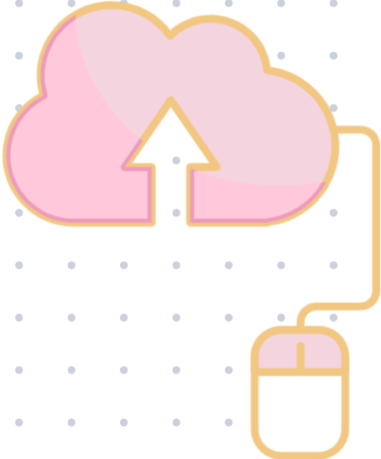
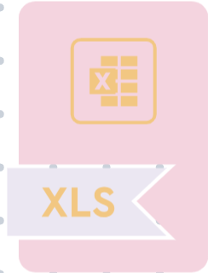
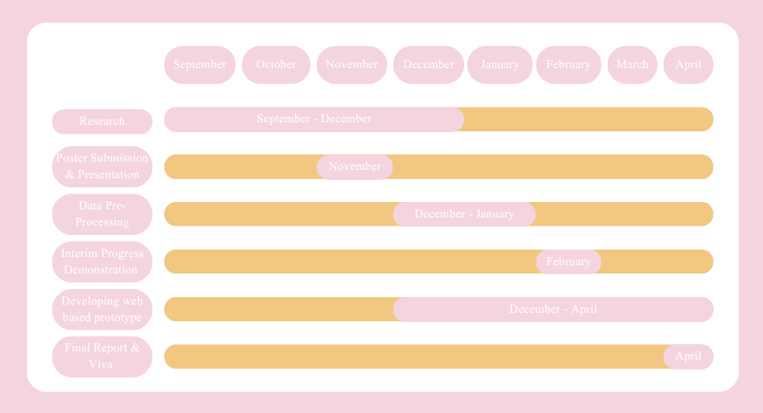
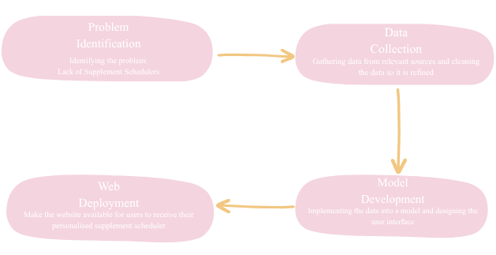
Supplement Scheduler
by Umme Aneesah
w1972265
Supervisor: Salma Chahed
The Problem
Aims & Objectives
The Solution
Vitamins and Supplements have become a part of our daily routines, but what schedule do we follow? The supplement market is highly competitive, making it challenging to determine which supplements to take and when to take them. Especially when multiple supplements are available, it is not possible to take them all at the same time, so scheduling becomes necessary to establish a more efficient supplement intake.
A website that provides personalised schedules based on the supplements inputted, It will take into account the recommended effective dosages and times to take these supplements throughout the day, for a more efficient outcome. Supplements are more effective when taken at the correct dosage and at specific times of the day, which most users are not aware of. Once a personalised schedule is created for the user, they should notice a change in the effectiveness of the supplements they take.
The Tools
To build a user-friendly web application using data-driven insights to generate personalised schedules to help users effectively implement and manage their daily nutrient intake.
The Skills
Uploading different materials used in the making of this project into a GitHub repository to keep track of the project as well as keep record of the project to use as a portfolio.
Programming the model based on the data for the website
Review articles with information about supplement dosages
Use Python to preprocess the supplement dataset
Develop a web-based prototype with a personalised supplement schedule
Researching relevant sources to use for the project
Coding using python language when developing the model that the website will be run on. Testing the data accuracy and system output.
Storing the dataset as an excel file so it can be run in the python code. Cleaning the features of the dataset in the excel file. Using filters to look through the datasets formatting.
Designing the user interface to make it user friendly and informative
Web deployment to make the website available for users
The When
The How
References
1. Vitamin deficiency detection using neural networks (2024). https://ieeexplore.ieee.org/abstract/document/10533044?casa_token=oAfRxhAegNkAAAAA:ftI5pHn8j-Zi7Zu8rmoE-3PHugiddrFgXrddskxv9fwCaR-oi5bX9toFj_9BmpmYB65DTwhbnQ
2. Lakshmi, N.N. et al. (2022) 'Vitamin deficiency and food recommendation system using machine learning,' International Journal for Research in Applied Science and Engineering Technology, 10(5), pp. 3823–3830. https://doi.org/10.22214/ijraset.2022.43236.
3. Bleizgys, A. (2021) 'Vitamin D dosing: Basic principles and a Brief algorithm (2021 update),' Nutrients, 13(12), p. 4415. https://doi.org/10.3390/nu13124415.
4. Mallesi, V., Sreedevi, P., Babu, G.U.K. and Rani, K.U., 2020. Finding of vitamin deficiency and food recommendation system using multiple classifier algorithms. MATERIAL SCIENCE, 19(02). https://materialsciencetech.com/mst/uploads/2020-41862.pdf
Notes:
⏱️ 0:00 – 1:30 — Opening & Introduction
“Hello Salma and Sheema, my name is Umme, and today I’m presenting my final-year project poster, which is a personalised Supplement Scheduler.
Many people regularly take vitamins or supplements, but they often don’t know when to take them for best absorption, how to avoid conflicts, or how to structure their intake across the day.
My project addresses this gap by creating a website that generates a personalised schedule based on the supplements a user already takes. It helps organise timing, frequency, and routine in a user-friendly and straightforward way.”
⏱️ 1:30 – 3:30 — Background & Problem Context
“There has been growing interest in using technology to assist with nutrition. For example, Mallesi (2020), Sabitha (2024), and Lakshmi (2022) used machine learning to detect vitamin deficiencies and recommend foods. Kirk (2022) predicted vitamin C levels using AI, and Bleizgys (2021) developed an algorithm for vitamin D dosage timing.
These studies show the importance of nutrients and the potential of technology, but they mainly focus on deficiency prediction — requiring medical data.
None of them focus on simple day-to-day supplement scheduling, which is something ordinary users struggle with.
That’s the gap my project fills: an accessible tool that organises supplements into a clear daily routine.”
⏱️ 3:30 – 5:00 — Aim & SMART Objectives
“The aim of this project is:
To build a user-friendly web application using data-driven insights to generate personalised schedules to help users effectively implement and manage their daily nutrient intake.
My objectives are:
Review articles with information about supplement dosages
Use Python to preprocess the supplement dataset
Develop a web-based prototype with a personalised supplement schedule.”
⏱️ 5:00 – 8:00 — Dataset & Data Preparation
“For this project, I curated a supplement dataset, which included: • Supplement names • Recommended dosages • Frequency • Best timing (morning, afternoon, evening) • Whether to take with food • and finally Interactions and conflicts
I cleaned this dataset using Excel and Python. I merged sheets, removed duplicates, standardised columns, and converted everything into a consistent format.
This prepared dataset will be the foundation for the rule-based model.”
⏱️ 8:00 – 11:30 — Rule-Based Model (Core Logic)
“This project does not diagnose deficiencies or make medical claims. Instead, it will use a rule-based model to organise supplements people already take.
Here’s how the rule-based model works:
Each supplement will have defined attributes, such as: • best_time • with_food • avoid_with • max_daily_doses
For example: • Iron — best in the evening, avoid calcium, on an empty stomach • Vitamin D — best in the morning, with food • and finally Magnesium — best before bedtime
The model will match the user’s input supplements to the rules and generates a schedule divided into Morning, Afternoon, Evening.
I chose a rule-based model instead of machine learning because it’s safer, transparent, medically neutral, and allows complete control over interactions.”
⏱️ 11:30 – 14:30 — System Design & Tools Used
“The system will be built using three primary tools:
Python — for backend logic, rule checking, schedule generation, and data processing. Excel — for initial dataset cleaning and structuring. GitHub — for backups and project organisation.
Not included in the poster, but for the website interface, I will use Streamlit. It will allow me to build a clean, interactive web app where users can input supplements and immediately see their generated schedule.
The design focuses on simplicity and clarity.”
⏱️ 14:30 – 16:30 — Testing & Evaluation
“I will test the system using a range of supplements and combinations.
Such as: • Whether timing rules were correctly applied • Whether conflicting supplements were separated • Whether the output schedule was readable and logical • AND FINALLY, whether the website interface was intuitive
TALK ABOUT GNATT CHART AND SKILLS AND THE HOW
⏱️ 19:30 – 20:00 — Closing Statement
“To conclude, I will develop a supplement scheduling system that is safe, user-friendly, and solves a real gap in everyday supplement routines.
Thank you, and I’m happy to take your questions.”
1. Why did you choose a rule-based model instead of machine learning?
Answer: A rule-based model is safer, more transparent, and appropriate for supplement timing. It avoids giving medical diagnoses and follows clear evidence-based rules from nutritional research.
2. How did you ensure the information you used was legal to reuse?
Answer: I used publicly available information and structured it into my own dataset. The system only schedules supplements the user already takes and does not make health claims.
3. How does your scheduler choose the best time for each supplement?
Answer: Each supplement in the dataset has assigned attributes:
Morning/Afternoon/Evening
With or without food
Max doses per day The scheduler applies these rules when creating the final timetable.
4. What challenges did you face while cleaning the dataset?
Answer:
Inconsistent formatting
Missing values for timing
Duplicate supplements
Converting text formats I solved this using Excel filters and Python preprocessing.
5. What would you improve with more time?
Answer:
Add search recommendations
Build a mobile app version
Allow users to receive daily reminders
Add a more advanced rule engine to handle complex interactions
6. Is your system medically safe?
Answer: Yes — the website only organises supplements that the user already takes. It does not prescribe or suggest new supplements. All advice is general scheduling guidance, not medical advice.
7. Why is scheduling important for supplements?
Answer: Because absorption varies — e.g.,
Magnesium → bedtime
Iron → away from calcium/caffeine
Vitamin D → with food Scheduling improves effectiveness.
8. What tools were most useful for development?
Answer: Python for logic, Excel for dataset cleaning, GitHub for documentation, and Streamlit for web deployment.
🎤 10-Minute Q&A — YOU WILL BE ASKED THESE
Here are the most likely questions:
1. Why did you choose a rule-based model instead of machine learning?
Because it’s safer, transparent, and ideal for scheduling without making medical decisions.
2. Where did your dataset come from?
A curated dataset containing supplement timing, dosages, interactions, and food requirements.
3. How does the system avoid giving medical advice?
The tool only organises supplements that the user already takes. It does not recommend or prescribe anything.
4. What was the biggest challenge?
Cleaning inconsistent dataset entries and defining accurate supplement timing rules.
5. How would you improve it with more time?
Adding reminders, mobile support, and downloadable calendars.
6. Could this be used in real life?
Yes — it’s practical, safe, and fills a real user need.

